Slide 1
Elicitation of Interaction Techniques with 3D Data Visualizations in Immersive Environment using HMDs
Authors: Farzana Aktar & Dr. Frank Maurer
Presenter: Farzana Aktar
Graduate Student
Department of Computer Science
University of Calgary, Canada
21st October 2022 (SGT)

Slide 2
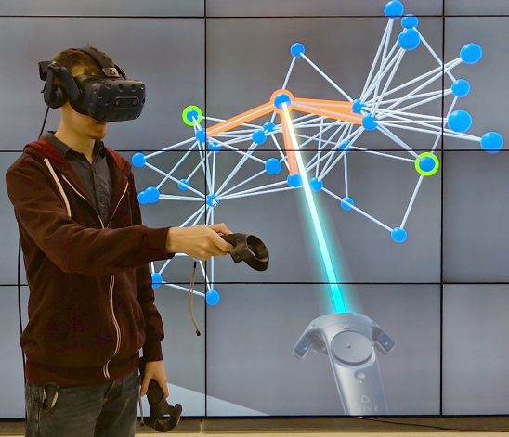
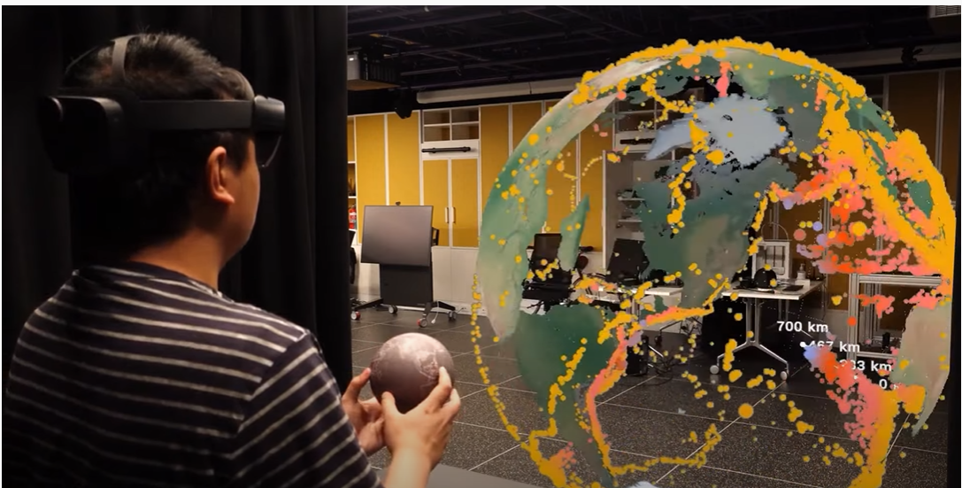
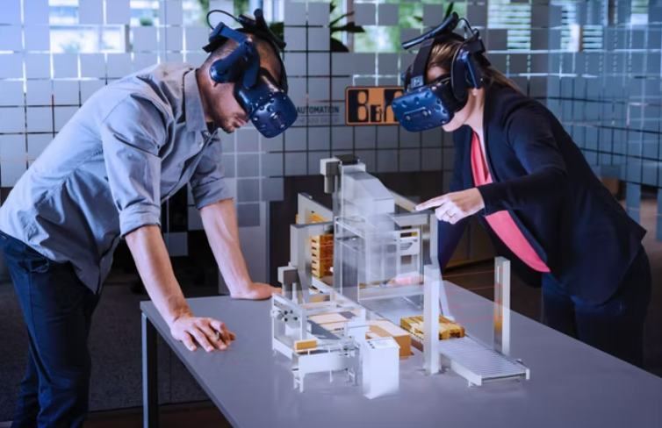
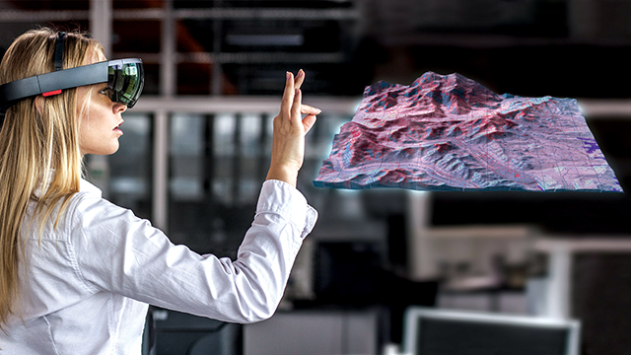
Network visualization [1]
Tangible Globe [3]
Model Analysis by Machine developers [4]
How do users want to interact with 3D visualizations in immersive environments?
Metaverse’s mining data visualization technology [2]
Notes:
As we are advancing towards future, extended reality, which is the umbrella term for Virtual, mixed and augmented reality, is becoming the future. So when we are in immersive environment, do we want to use controllers, or some physical metaphors or just bare hands to interact with the virtual objects, even after we choose the device to interact, how EXACTLY do we use that device of interaction?

Slide 3
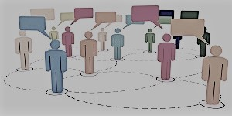
Motivation
Elicitation:
Referents
(select, rotate etc)
User-suggested set of interaction techniques
Elicitation by Jacob O. Wobbrock
40% DIFFERENCE
60%
Gesture sets
Designers
Users
Notes:
In order to answer to that very question, we are proposing a user-centered approach called elicitation. In an elicitation study, participants are provided with a set of system actions called referents and asked to suggest their preferred interaction techniques for those referents. The goal of our study is to find the interaction techniques that are most intuitive and natural to the users.
Also, Famous HCI researcher Jacob O. Wobbrock found 40% difference by comparing the gesture set proposed by designers and the set elicited from participants. Elicitation studies can help resolve this discrepancy by enabling users, instead of the designers of the system, to propose how they would like to interact.

Slide 4
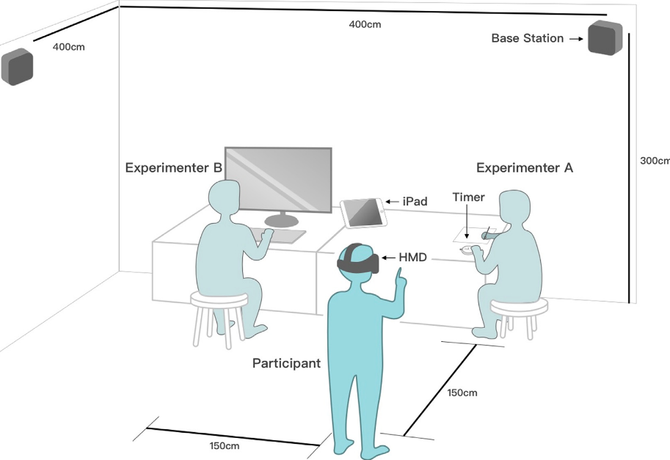
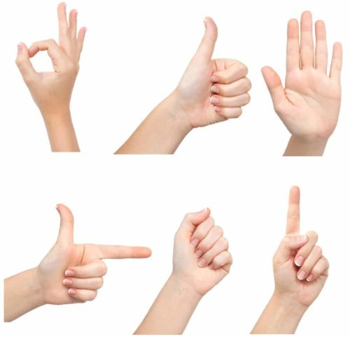
Factors Impacting Elicitation Studies
Legacy Bias
Wizard of OZ
Bias from prior technology
How to Avoid Legacy Bias
Priming
Partners
Production
Elicitation Setup [8]
Notes:
There is a major factor that affects the results of elicitation- legacy bias. The participants are most likely to be biased from their experience with previous technology. So to avoid those biases, researchers have proposed three methods: production- where one participant generates multiple techniques for a single referent. 2. Priming- where participants get informed about the technology before the study, and third, partners- where multiple participants can brainstorm their ideas before proposing a technique.

Slide 5
Evaluating Elicited Data
Quantitative evaluation
Qualitative evaluation
Learnability
Memorability
Ease of Execution
Ease of Conception
Goodness of fit
Agreement Score
Notes:
After we gather the elicited data, we need to evaluate them-> agreement score is the most widely used evaluation measure for elicitation study where you find the techniques that were most agreed upon by the participants.
Besides gathering the most popular interaction techniques, we can also assess and compare learnability, memorability, ease of execution and conception and goodness of fit of the proposed interaction techniques with the ones developed by the designers.

Slide 6
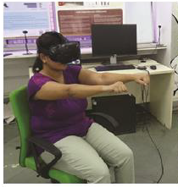
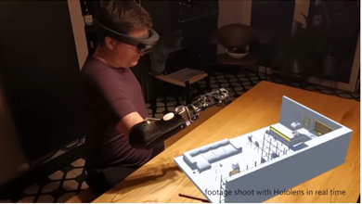
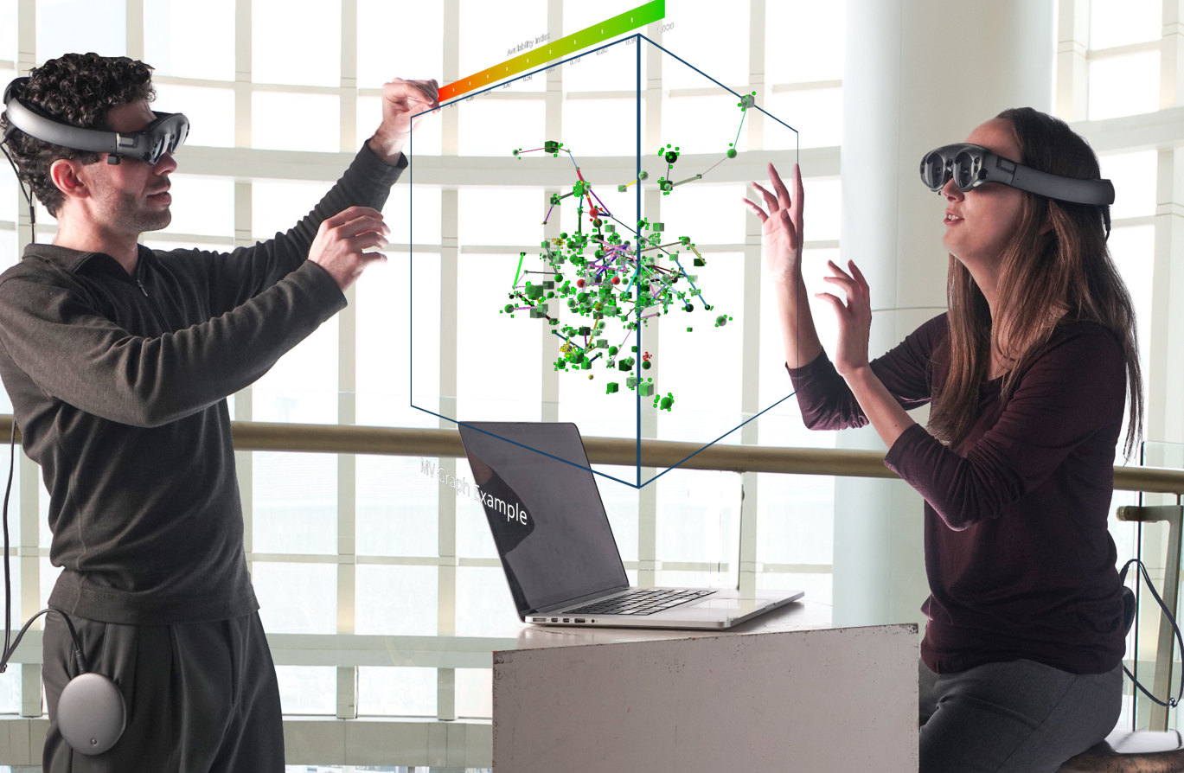
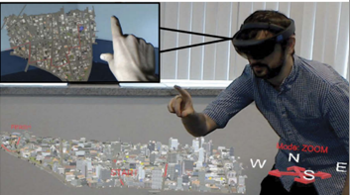
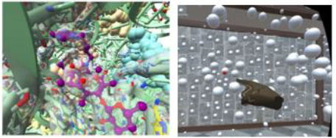
Interaction With Immersive 3D Data Visualization
Overcomes boundaries of the physical world & more input modalities!
Interaction techniques can vary for:
type of data
tasks
Relative position of data
scale of the environment
single vs collaborative systems
dense vs sparse visualizations
body position (sitting vs standing)
Demography & culture
Physical or mental ability
Social acceptance
Sitting position gestures [9]
Person with disability [12]
Immersive Collaboration [5]
Distance between viz and user-viewpoint [11]
Dense vs Sparse data [10]
Notes:
Now let’s talk about why it is so important to research elicitation specifically for interactions with 3d Data visualizations in immersive environments. Unlike conventional display based systems, the head mounted displays enable a whole new world with larger workspace and more input modalities. This opens up to certain interaction challenges regarding
……….
For truly understanding users’ perspective and preferences in dealing with these aspects of interactions, in this study we argue that elicitation of those preferences is of utmost importance.

Slide 7
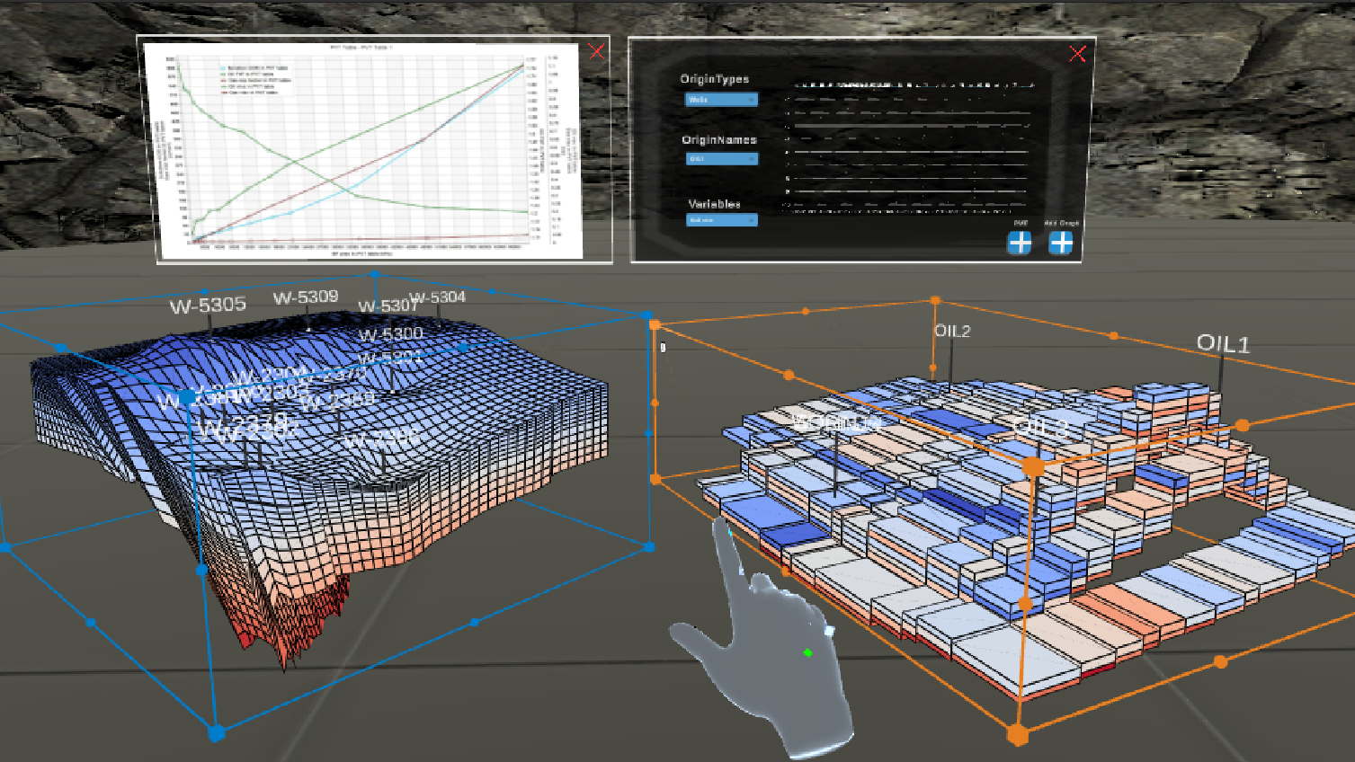
Thank You! Thoughts?

Slide 8
References
Kotlarek, Joseph, Oh-Hyun Kwon, Kwan-Liu Ma, Peter Eades, Andreas Kerren, Karsten Klein, and Falk Schreiber. "A study of mental maps in immersive network visualization." In 2020 IEEE Pacific Visualization Symposium (PacificVis), pp. 1-10. IEEE, 2020.
Satriadi, Kadek Ananta, Jim Smiley, Barrett Ens, Maxime Cordeil, Tobias Czauderna, Benjamin Lee, Ying Yang, Tim Dwyer, and Bernhard Jenny. "Tangible globes for data visualisation in augmented reality." In CHI Conference on Human Factors in Computing Systems, pp. 1-16. 2022.
https://www.canadianminingjournal.com/featured-article/miners-game-virtual-reality/
https://www.br-automation.com/en/about-us/press-room/technology-highlights/virtual-meets-reality/
https://devpost.com/software/tableau-in-hololens-2
Cartwright, Stephen, Steven Samoil, Bryson Lawton, Die Hu, Siqi Xie, Eric Wang, Amir Aminbeidokhti et al. "Enhancing Reservoir Engineering Workflows with Augmented and Virtual Reality." In SPE Canadian Energy Technology Conference. OnePetro, 2022.
https://austinstartups.com/sxsw-pitch-finalist-virtualitics-20a53ef6e9b4

Slide 9
References
W. Hou, G. Feng, and Y. Cheng. A fuzzy interaction scheme of midair gesture elicitation. Journal of Visual Communication and Image Representation, 64:102637, 2019
Ganapathi, Priya, and Keyur Sorathia. "Elicitation study of body gestures for locomotion in HMD-VR interfaces in a sitting-position." In Motion, interaction and games, pp. 1-10. 2019.
Bhowmick, Shimmila. "Exploring Body Gestures for Small Object Selection in Dense Environment in HMD VR for Data Visualization Applications." In 2021 IEEE Conference on Virtual Reality and 3D User Interfaces Abstracts and Workshops (VRW), pp. 713-714. IEEE, 2021.
https://www.army.mil/article/185515/keeping_it_real_natick_scientists_investigating_augmented_reality_as_a_mission_planning_tool
https://designawards.core77.com/Interaction/97012/Dots

